Slide 1


Chogori Project A memory centric distributed transactional platform, Distributed NewSQL service and more
Seattle Cloud Lab/Cloud Storage Team
12/31/2022

Slide 2
Overview
Chogori-OpenGauss is a new SQL service based on the open-source OpenGauss project, which is based on postgres 9.2.
Features
Disaggregated storage provided by the Schematized-Key-Value (SKV) chogori-platform project.
Horizontally scalable, multi-instance support
Shared and distributed SQL Catalog
Multi reader/writer architecture
Consistency is now as strong as possible: External Consistency (i.e. Strict Serializability with external causality) thanks to the K23SI transaction protocol.
TPCC NewOrder and Payment transaction support. Focus is on feature capability and not performance.
Implemented a new HTTP Proxy component for the SKV Platform, allowing access from multiple languages and tooling
Implemented a stand-alone SKVClient, which uses HTTP to perform all SKV operations. The library allows us to access SKV from the OpenGauss code.

Slide 3
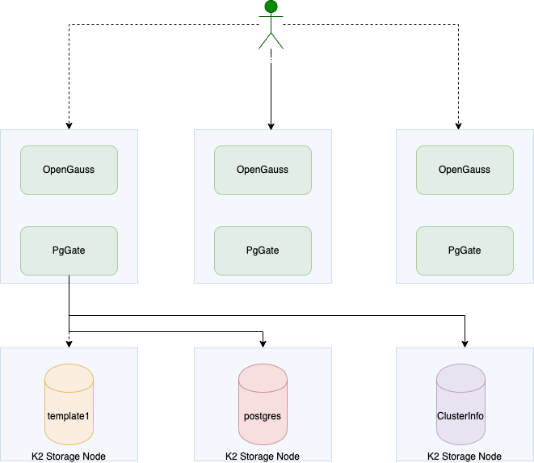
System Diagram
Multiple instances of OpenGauss in the cluster
User could start a session with any of the instances
Postgres interacts with K2 platform via PgGate layer
System catalog and data are stored on K2
Cluster info
Template0 DB
template1 DB
Postgres default DB

Slide 4
SQL Execution
SQL Query Plan (PG):
pass columns as column values
pass targets as column projection
pass filter conditions
pass aggregation and built-in functions
SQL Operation (PgGate):
Read request
Write request
Fetch response as PG tuples
K2 Operation (K2 Platform):
Single Read
Write
Scan
Filter expressions

Slide 5
Integration with OpenGauss
Integration logic customizes opengauss in the following areas
Bootstrap
Transaction
System Catalog
Index access
Table access
Cache refresh
DDLs
Scan via sequential scan, index scan, and index only scan
Memory context
Query Plan
All OpenGauss integration logic calls PgGate APIs to interact with K2 platform
K2 integration features are turned on only if the function IsK2PgEnabled() in k2pg_aux.h returns true

Slide 6
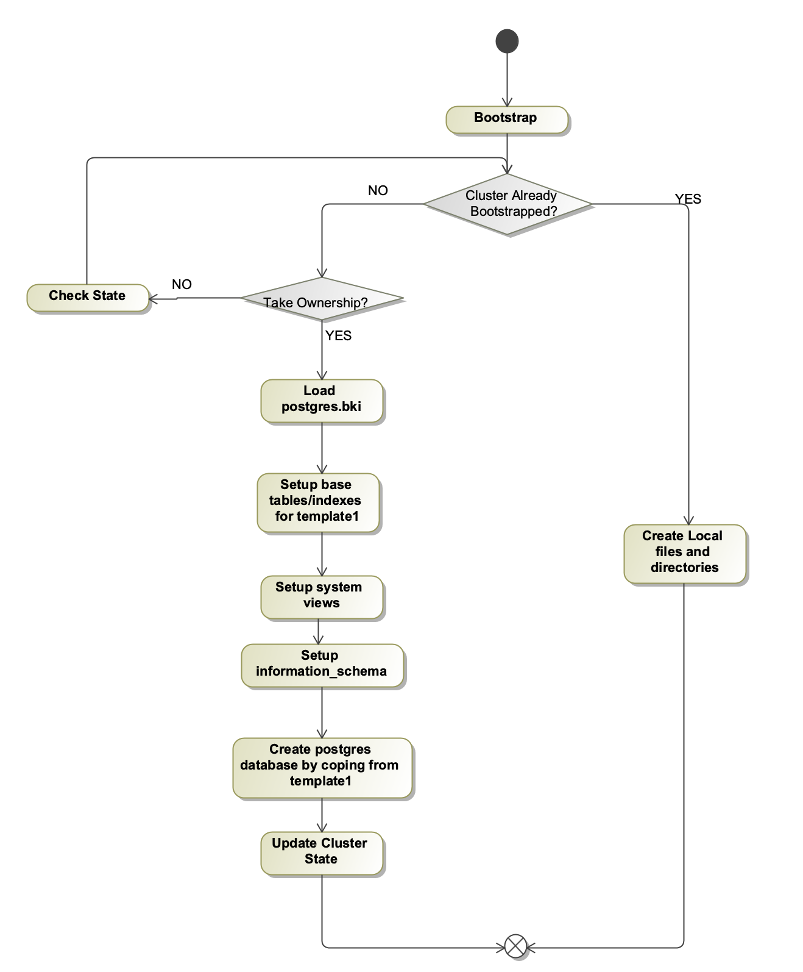
Bootstrap
A chogori-opengauss cluster needs to bootstrap before use
Only need to bootstrap once for the whole cluster
Create template databases, views, users, and other system tables for PG -> all stored on K2 instead of local
Flag initdb_done was set to true after the bootstrap finishes
The whole cluster only needs to be bootstrapped once from one instance; other instances run in local mode to create configuration files without the need to bootstrap again.

Slide 7
Transcation: TxnManager
src/gausskernel/storage/access/k2/session.cpp
Maintains a single chogori transaction per thread. Operations automatically start a transaction if one has not started.
Hooks into opengauss XactCallback mechanism to get transaction abort and commit events, which call chogori endTxn with abort or commit respectively.
PgGate calls all SKV operations through the TxnManager, which provides a thin wrapper over the SKVClient

Slide 8
Catalog Manager
Catalog manager runs on each individual opengauss process and share all the catalog data in K2 platform
Catalog Manager manages the following metadata
ClusterInfo
initdb_done
catalog_version
DatabaseInfo
database_name
database_oid
next_pg_oid
TableInfo/IndexInfo
PG system catalog
shared tables/indexes on template1 collection
Other tables/indexes on the collection associated with a DB
User tables/indexes
SKV schema system tables (maintain our own table meta data to avoid aggregate PG system catalog tables) <-> TableInfo/IndexInfo
skv_schema_table_meta
skv_schema_tablecolumn_meta
skv_schema_indexcolumn_meta

Slide 9
DDLs
K2 ddl operations are defined in k2cat_cmds.h
K2 ddl operations intercept ddl commands and update catalog metadata on K2 platform instead of local file systems.
K2PgCreateDatabase
K2PgDropDatabase
K2PgReservePgOids
K2PgCreateTable
K2PgDropTable
K2PgCreateIndex
K2PgDropIndex
K2 ddl provides two additional calls for a chogori-opengauss cluster
K2InitPGCluster: initialize the PG_DEFAULT_CLUSTER k2 collection to hold cluster level information
K2FinishInitDB: set the initdb finish flag to be true in k2 platform after the bootstrap finishes

Slide 10
Table System Columns
Chogori-opengauss extends Postgres table system columns, for example, oid, cmin, cmax, and so on, to add the following new system columns
K2pgctid: virtual column representing K2 record key, similar to Postgres's SelfItemPointer/ctid column
k2pgrowid: auto-generated key-column for tables without any primary keys, k2 cannot store duplicate records with the same key directly. This column is not visible to postgres
k2pgidxbasectid: the k2pgctid of base table row in an index
k2pguniqueidxkeysuffix: extra key column for unique indexes, used to ensure SQL semantics for null (null != null) in K2 PG

Slide 11
Table Operations
Hook in K2 logic in nodeModifyTable.cpp
K2 table operations are defined in k2_table_ops.cpp
Operations: k2pgctid is used to reference a row for update and delete operations
Insert
K2PgHeapInsert
K2PgExecuteInsert
K2PgExecuteInsertIndex: cascade index insert after a tuple insert
Update
K2PgExecuteUpdate
K2PgUpdateSysCatalogTuple
Delete
K2PgExecuteDelete
K2PgExecuteDeleteIndex: cascade index delete after a tuple delete
K2PgDeleteSysCatalogTuple

Slide 12
Index Access
No primary index is defined or needed for a base table
K2 does not support secondary index natively and a secondary index is a regular SKV schema on K2
K2 index is defined as a new index type in builtin_funcs.ini, pg_am.h, pg_opclass.h, and pg_opfamily.h
k2_index_ops.h defines the index access functions for k2 index, for example,
k2inbuild
k2ininsert
k2inbeginscan
k2ingettuple
k2indelete
K2 index intercepts the default B tree index access and redirects it to k2 index when IsK2PgEnabled() in k2pg_aux.h returns true
Some cascade index operation for a tuple operation is handled in k2_table_ops.cpp directly

Slide 13
Scan Operations
K2 logic is hooked into sequential scan, index scan, and index only scan to redirect the scan operation to k2 platform instead of local file systems
K2 system table and heap scan operations are defined in k2catam.h, for example,
System table scan
cam_systable_beginscan
cam_systable_getnext
cam_systable_endscan
Heap scan
cam_heap_beginscan
cam_heap_getnext
cam_heap_endscan
Index only scan is handled by index functions in k2_index_ops.h directly
k2inbeginscan
k2ingettuple
k2inendscan

Slide 14
Memory Context
Postgres uses memory context, i.e., a chunk of memory for a query statement and it will be reclaimed in whole at the end to avoid memory leaking during query execution.
K2 PG added an entry k2pg_memctx to MemoryContext object to hold k2 related data structures for a query
Postgres switches memory contexts during query execution, GetCurrentK2Memctx() in mcxt.cpp returns the current k2pg_memctx
PgMemctx is defined in pg_memctx.h to hold data structures used in PgGate. These data structures are C++ objects and cannot be released using default C memory apis. Instead, they are released by C++ destructors.

Slide 15
Cache Refresh
Postgres manages system catalog cache internally in catcache.cpp, relcache.cpp, and syscache.cpp
K2 logic updated the above files for cache load and refresh from k2 platform
catalog_version is defined for the system catalog. Its value increases after a catalog metadata update.
catalog_version is stored as part of ClusterInfo in K2 platform
K2 uses catalog_version to invalidate caches after a version change

Slide 16
PgGate
Bridge between core opengauss code and Chogori storage code
API for DML (insert, select, etc) and DDL (create table, etc.) called by opengauss code
Important files:
src/gausskernel/storage/access/k2/pg_gate_api.cpp
src/gausskernel/storage/access/k2/storage.cpp

Slide 17
PgGate, Chogori data mapping
Database -> Chogori collection
Table heap data -> Chogori schema + SKV records
Index -> Chogori schema + SKV records
Heap row data -> SKV record: TableID + IndexID + K2PgRowID + Attribute Fields
TableID and IndexID fields keeps the data together for tables and indexes on as few chogori partitions as possible
K2PgRowID is a randomly generated int64 that guarantees uniqueness
TableID, IndexID, RowID are the composite chogori key
Index row data -> SKV record: TableID + IndexID + Indexed Fields + K2PgIndexBaseTupleId
TableID, IndexID, Indexed Fields are the composite chogori key
For non-unique indexes, K2PgIndexBaseTupleId is also part of the composite chogori key
The K2PgIndexBaseTupleID can be used to reconstruct the key fields of the corresponding heap record

Slide 18
PgGate, K2PgTupleId
Similar to opengauss ctid or self item pointer
Uniquely identifies a row and is static for the lifetime of that row (not like a memory pointer that can be relocated)
Used for updates and deletes to identify the row to operate on, and for indexes to lookup the base heap data
The K2PgIndexBaseTupleID value in an index record is equal to the corresponding heap row’s K2PgTupleId
A K2PgTupleId is an opengauss datum that can be deserialized into an SKVRecord with the record’s key fields already serialized
Internally, SKVRecords are serialized to a datum using MsgPack encoding

Slide 19
PgGate, Data attribute mapping
Opengauss statically sized 1/2/4/8 byte attributes -> Chogori SKV Int16/Int16/Int32/Int64 field types
Exceptions: BOOL -> Bool, FLOAT4 -> Float, FLOAT8-> Double
Opengauss internal tables use 32 bit unsigned int types (e.g. OID, XID, REGPROC, etc.). These are mapped to SKV Int64 so that they cannot overflow and so that inequality comparisons are valid.
All other types mapped to SKV String type which is dynamically sized and supports null characters.
Whitelist types that we know ordering on SKV matches opengauss ordering. For these types we can pushdown filter operations to SKV. Includes common string (VCHAR, TEXT, CSTRING, NAME) and integer types.
src/include/access/k2/k2_types.h

Slide 20
PgGate, Insert
PgGate_ExecInsert
Inserts into a single heap base table or index
List of datums, attribute numbers, and attribute types passed to PgGate
Datums converted to SKVRecord
SKV write operation issued

Slide 21
PgGate, Update
PgGate_ExecUpdate
List of datums, attribute numbers, and attribute types passed to PgGate
If K2PgTupleId passed in, then it is decoded into a partial SKVRecord with keys
SKV partial update issued

Slide 22
PgGate, Delete
PgGate_ExecDelete
K2PgTupleId passed to PgGate to identify row to delete
SKV write with erase operation issued

Slide 23
PgGate, Select
PgGate_NewSelect, PgGate_ExecSelect, PgGate_DmlFetch
Constraints (WHERE clauses) passed as a list of logically ANDed conditions
Conditions can be equals, inequalities, between, or in, with a column reference and a constant arguments.
Unsupported conditions will be evaluated by opengauss correctly but not passed down to chogori SKV
PgGate implements three scan types: sequential scan, index scan, and index only scan
Sequential scan: Whole table scan on base table heap, with filters passed down to SKV
Index scan: Scan on index schema where PgGate will automatically find and return the corresponding rows of the base table
Index only scan: Scan on index schema where the rows returned are constructed from index records directly (e.g. covering indexes)
Implemented as an SKV Query. Query start and end range records and filters are constructed from the constraints passed in.
Prefetching query pages and reading base table records from index records are done in parallel with opengauss record processing

Slide 24
SKVClient
C++ library provided by chogori-platform project that has the API for SKV operations
Unlike the chogori-platform “native” client, SKVClient does not require Seastar
Communicates with the Chogori HTTPProxy via HTTP and MsgPack
Uses boost futures to provide asynchronous operation
The intended deployment is that each opengauss instance is paired with a HTTProxy instance on the local host

Slide 25
Current Status – Working
Initdb to initialize opengauss, and ”local initialization” to start an opengauss instance when initdb has already completed against a running Chogori cluster
Multi-user mode
Basic DDL: Create database, create table, create index
Basic DML: Insert, update (including expressions in the SET clause), delete, and select with where clauses
Covering indexes. Used by the planner to issue PgGate index only scans
TPC-C load phase and transaction types New Order, Payment, Order Status, and Delivery. Tested with standard jdbc benchmark driver (OLTPBench) with minor tweaks (see next slide)

Slide 26
Current Status – Known Problems
Alter table not supported
Unique constraints not supported
Drop table not supported
“FOR UPDATE” clause not supported and has no use when using Chogori transactions
Non-covering indexes are not used by the planner
Predicates not pushed down for sequential scan

Slide 27
Project Links
Main repository: https://github.com/futurewei-cloud/chogori-opengauss
SKV: https://github.com/futurewei-cloud/chogori-platform
TPCC benchmark: https://github.com/futurewei-cloud/chogori-oltpbench
Build instructions: https://github.com/futurewei-cloud/chogori-opengauss/blob/mainline/BuildOpenGauss.md

